Slide 1
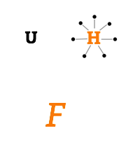
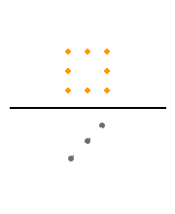
1
2
(a) The dots form a circle around their letter.
(b) The dots surround their letter.
(a) Some dots form a square.
(b) Some dots are arranged as a square.

